Slide 1

SQA Advice
Plagiarism and Writing Folio

Slide 2

What is plagiarism?
Plagiarism is the practice of taking someone else’s work or ideas and passing them off as one’s own.
This can be intentional or unintentional but the consequences are still the same.

Slide 3

Why candidates plagiarise
There are many reasons why candidates might resort to plagiarism:
1 Lack of understanding about what plagiarism really is.
2 Time-management issues - not being aware of how much research and effort should go into coursework; not realising that extensions can occasionally be granted due to extenuating circumstances (e.g. accidents, illness etc.)
3 Wanting to achieve high marks in their coursework, (hopefully) to get a better result for the whole subject.

Slide 4

Why candidates plagiarise
4. An out-and-out desire simply to beat the system. Often, plagiarism occurs because of a lack of understanding by the candidate about acceptable practices. Broadly speaking, plagiarism can be categorised as intentional or unintentional.

Slide 5

Intentional plagiarism
Buying an essay from an internet site (also known as an ‘essay bank’ or a 'paper mill’).
Getting someone else to do the work for them.
Giving false information about a source used in coursework.

Slide 6

Unintentional plagiarism
Copying and pasting from the internet without citing the source.
Omitting quotation marks from quotations.
Paraphrasing without including reference to the source of the paraphrase.
Copying sections from a friend.
Copying pieces produced in earlier academic years — not realising these could be included in their final coursework submission.

Slide 7

It’s more common than you think
Loads of people have been accused of plagiarism
Ed Sheeran has been accused of plagiarising Marvin Gaye’s ‘Let’s Get it On’ – it does sound a lot like ‘Thinking Out Loud’ AND apparently ‘Photograph’ has striking similarities to Matt Cardle’s ‘Amazing’.
Olivia Rodrigo has been accused of plagiarising ‘Pump It Up’ by Elvis Costello for her song ‘Brutal’ but that’s okay, Elvis doesn’t mind.
Melania Trump, Martin Luther King Jr and Barack Obama have all also been accused.
Bottom line, it can be easy to do unintentionally.

Slide 8
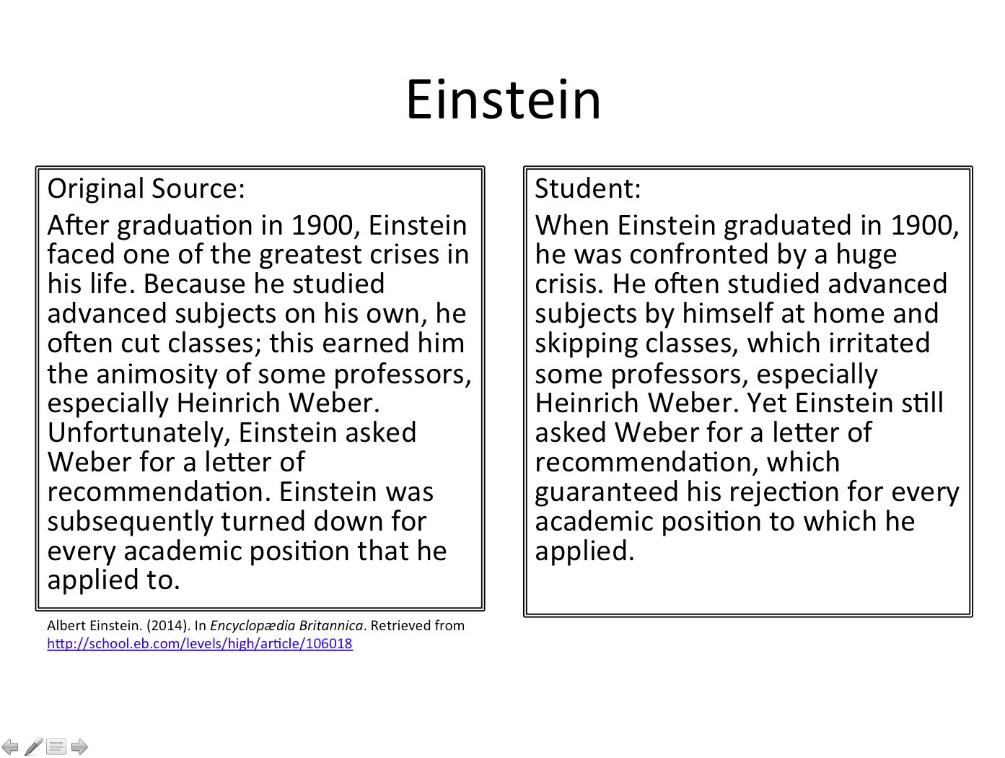

Examples

Slide 9

Example 2
We will always be connected. We have known each other since we were children and have loved each other deeply. His sadness has been my sadness and I have felt it as keenly as he has. If the world ended tomorrow and he lived, then I would be alive through him. If it were the other way around I would be lost. Yes, I love my husband but my love for him will change like winter changes the trees. My love for……..HEATHCLIFF(?????) is like the rock beneath our feet.

Slide 10

The principal rules for compiling and submitting coursework
1 Candidates’ coursework should be in their own words, unless they are quoting from a referenced source. If they are asked to explain what they mean by a certain phrase or paragraph, they should be able to do so.
2 Candidates should always credit work that is not their own, regardless of where the ideas came from.
3 Candidates should be advised of the risks associated with using essay banks, essay-writing services etc. - these are services that are available from the internet and offer to provide candidates with coursework materials for a fee.

Slide 11

The principal rules for compiling and submitting coursework
4 Setting expectations is an important step in helping candidates to understand the academic standards required. It is important that candidates understand that, when they sign the authentication statement on the flyleaf, that they are confirming that the work is their own and that any ideas or words belonging to someone else are correctly acknowledged.

Slide 12

Key Messages
We can spot plagiarism almost all of the time.
The consequences are severe – candidates may lose all of the qualifications gained in that year even if they only plagiarised in one subject.
There is always another option. If you are short on time, tell us. If you are struggling to get your thoughts on to paper, tell us. If you need more help with referencing evidence, tell us.

Slide 13

Folio/ Assessment Deadlines
30 % of final grade
One pieces submitted: either broadly creative or broadly functional
Deadlines:
December - National 5 English Folio Deadline
January - Higher English Folio Deadline

Slide 14

Further Information
There a number of free plagiarism checkers on the internet for you to check your own work.
An acceptable similarity report is usually around 24% or below. Anything above that is a red flag and you should speak to your teacher for advice.

