Slide 1
Online Support
Senior Information Evening

Slide 2
OverVIEW
This session considers some of the main supports that can be used in general for all subjects in preparing for SQA examinations and more.
The principal areas to consider are:
BBC Bitesize
Glow
Teams
Satchel One
West OS
e-Sgoil

Slide 3
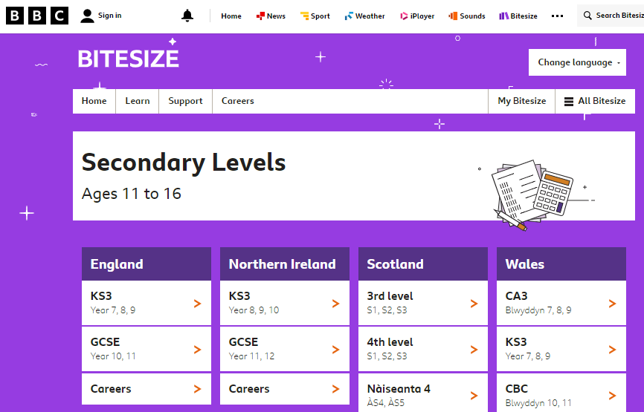
BBC BitESIZE
Curriculum modelled on SQA Scottish curriculum (as well as for GCSE and A level in England)
Resources updated by Scottish teachers
Provide short, sharp manageable chunks of information directly related to syllabus content
Useful end of unit revision exercises for self-testing
Johnstone High School Senior Information Evening

Slide 4
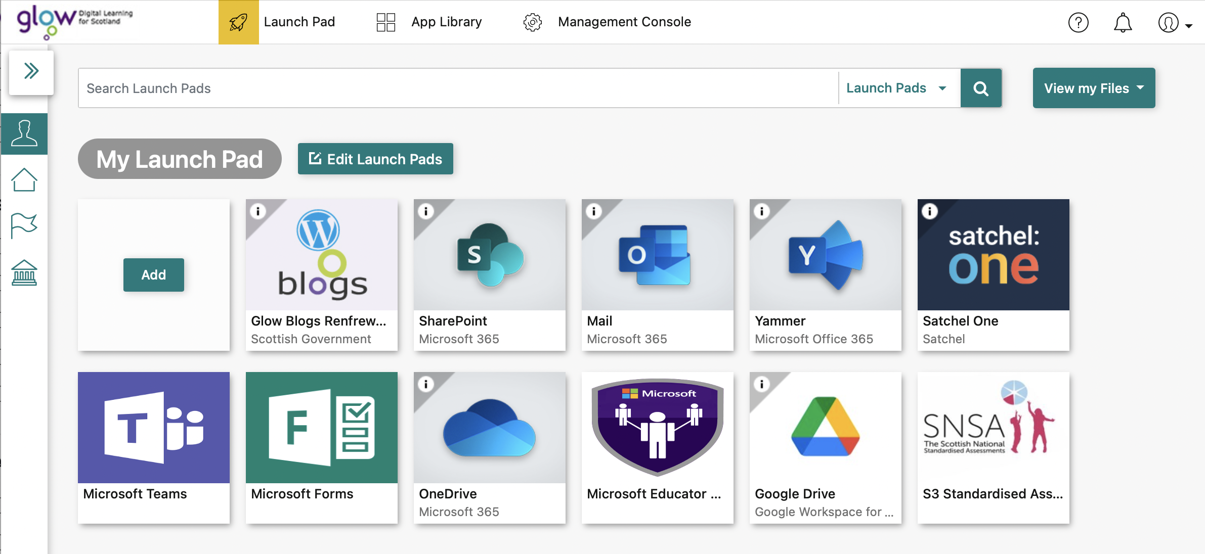
Glow
Every pupil (and member of staff has a Glow account)
All Glow accounts work (regardless of what might be suggested)
Glow is the platform that provides access to many of the other services outlined here (such as Teams and Satchel One displayed below)

Slide 5
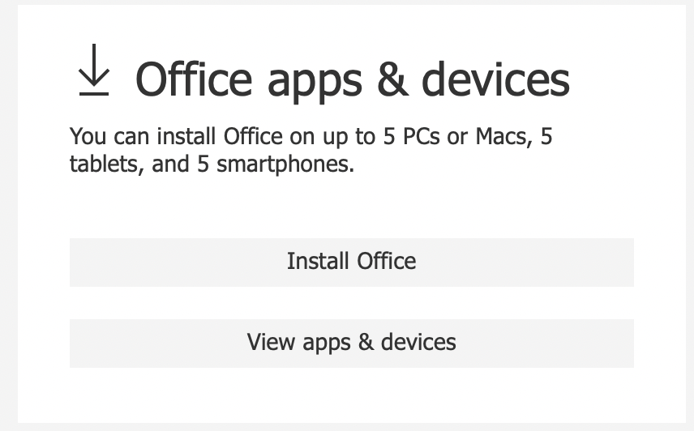
Glow
Provides access to other online platforms
Provides access to software such as Microsoft Office
Pupils can download this software for free through the Glow
Platform for use on desktops, laptops and mobile devices

Slide 6
Teams
Teams can be accessed via Glow. This allows a user to access all their teams via the browser (such as Chrome or Safari) by entering their (Glow) username and password.
They must enter their email add-on (@glow.sch.uk) when entering the username to successfully log into Teams
From there, it is possible to download the desktop (or mobile) version of Teams which can then be used in future without the need to logon
The app version also allow for notifications - no excuses for missing that homework reminder from the teacher when notifications are enabled

Slide 7
Teams
Teams is where pupils are likely to be provided with many Assignments (subject dependant)
If every pupil has a Glow account (they do), then they also have a Teams account
With notifications enabled, whenever an Assignment is posted the pupil will receive notification of this
This indicates the value of having the Teams app downloaded to mobile devices
If there is no room on the device for Teams – delete Tik Tok and get Teams installed
Teams allows access to conversations, assignments, files, class notebooks and more
Let’s have a look

Slide 8
Satchel One
Accessed via Glow
Pupils can download the App which again allows notifications to be received
To log into the mobile App, the RM Unify button must be used – and then log on as if logging onto Glow (with the email addon required again)
Unlike Teams, Satchel One has been configured to allow parents to have an account to see homework that has been set within Satchel One
Many teachers will use Teams as their main method for assigning work – with a link that work is on Teams being relayed within Satchel One

Slide 9
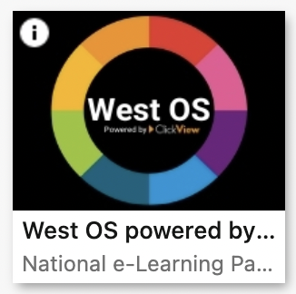
West OS
Once more – access from within Glow (no App for this platform)
Contains a wealth of video resources, created by Scottish teachers throughout the country to support delivery of National qualifications at all levels in all manner of subjects
An excellent resource for revision, especially for a topic where a student may have missed aspects of the topic in class.

Slide 10
E-Sgoil
Once more - accessed via Glow
Originally a resource to allow remote learning access to pupils in the Highlands and Islands
Links built with Education Scotland, West OS and other partners to allow the platform to thrive and reach out to learners throughout Scotland
Often provides ‘live’ lessons with schedules announcing when a particular topic will be studied

